Slide 1
Bank Marketing Campaign Analysis
Business Analytics Case Study by Esther M.

Slide 2

Business Problem:
Why some customers subscribe to term deposits while others do not.
Which customer segments are most likely to respond positively to marketing campaigns.
How marketing resources can be allocated more effectively.
Objective
Identify the key factors influencing subscription behavior and provide data-driven recommendations.

Slide 3

Dataset Overview
Dataset: Bank Marketing Dataset
Records: 11,162 customers
Variables: 17
Missing Values: 0
Target Variable: Deposit Subscription (Yes/No)

Slide 4
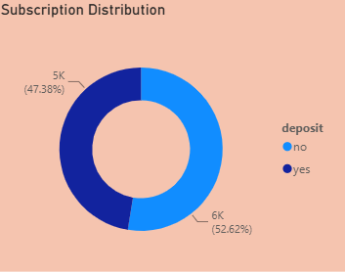
Data Includes:
Customer demographics
Financial information
Marketing campaign history
Contact methods
Previous campaign outcomes

Slide 5
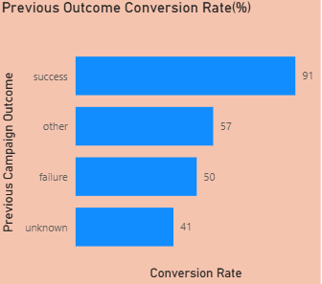
Key Finding #1.
Previous Campaign Success Drives Future Success
Insight:
Customers who previously subscribed following
a marketing campaign achieved a conversion rate of 91.32%.
This was the strongest predictor of future
subscription behavior.

Slide 6
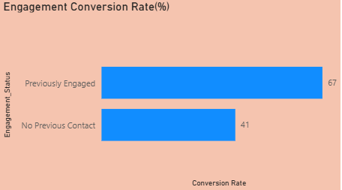
Key Finding #2.
Customer Relationships Matter
Insight:
Customers with previous engagement
Converted at 67.12%
Building customer familiarity significantly
improves campaign effectiveness.

Slide 7
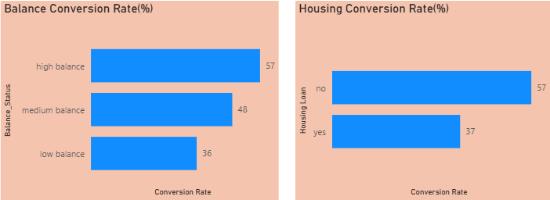
Key Finding #3.
Financial Position Influences Subscription
Insights:
High-balance customers
converted at 57.49%
Customers without housing
loans converted at 57.03%
Customers with housing
loans converted at only 36.64%

Slide 8
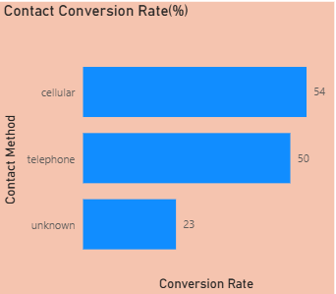
Key Finding #4.
Communication Channel Matters
Insight:
Cellular communication produced the
highest conversion rate of 54.33%

Slide 9

Recommendations:
✅ Prioritize customers with previous campaign success
✅ Expand customer engagement and nurturing programs
✅ Target high-balance customer segments
✅ Focus campaigns on customers without housing loans
✅ Use cellular communication as the primary contact channel

Slide 10
Conclusion:
Previous campaign success, customer engagement history, financial position, and communication channels are the strongest drivers of term deposit subscriptions. By targeting high-potential customer segments and improving campaign strategy, the bank can increase conversion rates and improve marketing efficiency.

